Slide 1

USING PIPELINED AND PARALLEL TABLE FUNCTIONS (ORACLE)
BY
Ramesh nadavati

Slide 2
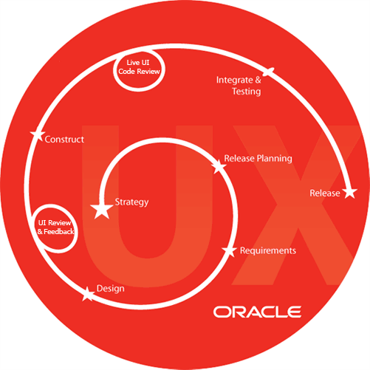
Topics
Overview of table functions
Pipelined table functions
Parallel table functions
Input data streaming for table functions
Parallelizing creation of a domain index
Transient and generic types

Slide 3
Overview of table functions:
Table functions are functions that produce a collection of rows that can be queried like a physical database.
A table function can take a collection of rows as input.
By enabling multithread and concurrent execution of table functions.
By eliminating intermediate staging between processes.
It improves the query response time by enabling pipeline techniques.
It also reduce the required memory of a table functions.

Slide 4
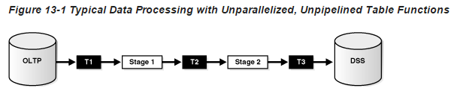
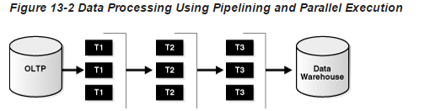

Slide 5
Pipelined Table Functions:
Data said to be pipelined if it is consumed by a consumer (T) as soon as the producer (T) produce it, without being staged in tables or a cache before being input to the next transformation.
Pipeline enables a table function to return rows faster and can reduce the required memory in cache a table functions.
It return the table function’s result collection in subsets. The return collection behaves like a stream that can be fetched from on demand. This makes it possible to use a table function like a virtual table.
1. Native PL/SQL approach: the consumer and producers can run on separate threads and communicate through a pipe or queuing mechanism.
2. interface approach: run on the same execution thread. Producer explicitly returns the control back to the consumer after producing a set of result.

Slide 6
Pipelined Table Functions with REF CURSOR Arguments: it accepts any argument that regular functions accept.
It accepts a REF CURSOR as an argument can serve as a transformation function and to fetch the input rows, perform some operation on them, and then pipeline the results out.
Parallel Execution of Table Function: parallel enabling table functions allows their work load to be split between multiple slave processes, which may result in faster execution.
Pipelined Table Functions (con’s):
1.implementation choices for pipelined table functions: interface approach requires the user to supply a type that implements a predefined oracle interface consisting of start, fetch, and close operations.
Type is associated with the table function when the table function is created, the fetch method is invoked repeatedly to iteratively retrieve the results. In the interface type is associated with the TF can be implemented in any supported internal or external language.

Slide 7
A single PL/SQL includes a special instruction to pipeline results out of the function instead of returning the whole collection as a single value. It does not effect the way pipelined TF implement used.
Declaration of Pipelined Table Functions pipelined TF declared by a keyword called PIPELINED , it must be a collection type (a nested table or a v array).
Example: CREATE FUNCTION GetBooks(cat CLOB) RETURN BookSet_t PIPELINED USING BookMethods;
Implementing the Native PL/SQL Approach: pipe row cause a table function to pipe a row and continue processing. The statement enables a pl/sql TF to return rows as soon as they are produced.
CREATE FUNCTION StockPivot(p refcur_pkg.refcur_t) RETURN TickerTypeSet PIPELINED IS out_rec TickerType := TickerType(NULL,NULL,NULL); in_rec p%ROWTYPE;

Slide 8
BEGIN LOOP FETCH p INTO in_rec;
EXIT WHEN p%NOTFOUND;
-- first row
out_rec.ticker := in_rec.Ticker;
out_rec.PriceType := 'O';
out_rc.price := in_rec.OpenPrice;
PIPE ROW(out_rec);
-- second row
out_rec.PriceType := 'C';
out_rec.Price := in_rec.ClosePrice;
PIPE ROW(out_rec);
END LOOP;
CLOSE p;
RETURN;
END;
/

Slide 9
Pipelining Between PL/SQL Table Functions: with serial execution, using an approach similar to co-routine execution results are pipelined from one PL/SQL table function to another.
Example: the following statement pipelines results from function g to f:
SELECT * FROM TABLE(f(CURSOR(SELECT * FROM TABLE(g()))));
Parallel executions works similarly except that each function executes in a different process or set of process.
Combining PIPE ROW with AUTONOMOUS_TRANSACTION:
If a table function is part of an autonomous transaction, it must COMMIT or ROLLBACK before each PIPE ROW statement to avoid an error in the calling subprogram. Because a restriction on combining table functions and PRAGMA AUTONOMOUS_TRANSACTION has been introduced in the 10g (10.1) release because table functions pass control back and forth to a calling routine as rows are produced.

Slide 10
Implementing the interface approach: to use this interface, you must define an implementation type that implements the ODCI Table interface. It consists of start, fetch, and close these are specified by oracle and which you implement as methods of the type.
Start: Initialize the scan context parameter. This is then used during the second phase.
Fetch: Produce a subset of the rows in the result collection. This routine is invoked as many times as necessary to return the entire collection.
Close: Clean up (for example, release memory) after the last fetch.
Prepare and describe are also two optional parameters of ODCI Table interface

Slide 11
Scan context: it is defined by the attributes of the implementation type. For the fetch to produce next set of rows, a table function needs to be able to maintain context between successive invocations of the interface routines to fetch another set of rows. A table function preserves the scan context by modelling it in an object instance of the implementation type.
Start Routine: The start routine ODCI Table Start is the first routine that is invoked to begin retrieving rows from a table function.
Example: STATIC FUNCTION ODCITableStart(sctx IN OUT <imptype>, <args>) RETURN NUMBER;
Fetch Routine: The fetch routine ODCI Table Fetch is invoked one or more times by Oracle to retrieve all the rows in the table function's result set. It returns the next subset of one or more rows.
Example: MEMBER FUNCTION ODCITableFetch(self IN OUT <imptype>, nrows IN NUMBER, rws OUT <coll-type>) RETURN NUMBER;
Close routine: The close routine ODCI Table Close is invoked by Oracle after the last fetch invocation. It performs the necessary cleanup operations.
Example: MEMBER FUNCTION ODCI TableClose(self IN <imptype>) RETURN NUMBER;

Slide 12
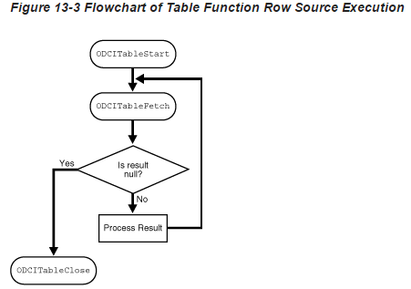

Slide 13
Describe method: The routine, ODCI Table Describe, is invoked by Oracle at query compilation time to retrieve the specific type information.
Example: CREATE FUNCTION AnyDocuments(VARCHAR2) RETURN ANYDATASET PIPELINED USING DocumentMethods;
Prepare method: The prepare method is invoked at query compilation time. It generates and saves information to decrease the execution time of the query.
Example: STATIC FUNCTION ODCITablePrepare(sctx OUT <imptype>, tf_info SYS.ODCITabFuncInfo, <args>);
Performing DML Operations Inside Table Functions:
CREATE FUNCTION f(p SYS_REFCURSOR) return CollType PIPELINED IS PRAGMA AUTONOMOUS_TRANSACTION; BEGIN ... END;
Performing DML Operations on Table Functions:
CREATE FUNCTION f(p SYS_REFCURSOR) return CollType PIPELINED IS PRAGMA AUTONOMOUS_TRANSACTION; BEGIN ... END;

Slide 14
Example:
CREATE VIEW BookTable AS SELECT x.Name, x.Author FROM TABLE(GetBooks('data.txt')) x;
CREATE TRIGGER BookTable_insert
INSTEAD OF INSERT ON BookTable
REFERENCING NEW AS n
FOR EACH ROW
BEGIN ...
END;
INSERT INTO BookTable VALUES (...);

Slide 15
Parallel Table Functions: it must have a partitioned input parameter, parallelism turned when only both the conditions satisfied. Function should have the PARALLEL_ENABLE clause in its declaration. Exactly one REF CURSOR is specified with a PARTITION by CLAUSE.
Inputting Data with Cursor Variables:
You can pass a set of rows to a PL/SQL function in a REF CURSOR parameter. For Example: FUNCTION f(p1 IN SYS_REFCURSOR) RETURN ... ;
Using Multiple REF CURSOR Input Variables:
PL/SQL functions can accept multiple REF CURSOR input variables:
Examples: CREATE FUNCTION g(p1 pkg.refcur_t1, p2 pkg.refcur_t2) RETURN... PIPELINED ... ;
Explicitly Opening a REF CURSOR for a Query:
You can explicitly open a REF CURSOR for a query and pass it as a parameter to a table function:
Example: BEGIN OPEN r FOR SELECT * FROM TABLE(f(...)); -- Must return a single row result set. SELECT * INTO rec FROM TABLE(g(r)); END;

Slide 16
Input data partitioning:
The table function declaration can specify data partitioning for exactly one REF CURSOR parameter.
Syntax:
CREATE FUNCTION f(p <ref cursor type>)
RETURN rec_tab_type PIPELINED PARALLEL_ENABLE(PARTITION p BY [{HASH | RANGE} (<column list>) | ANY ]) IS
BEGIN ...
END;
Parallel Execution of Leaf-level Table Functions:
To use parallel execution with a leaf-level table function—that is, a function to perform a unitary operation that does not involve a REF CURSOR—arrange things so as to create a need for a REF CURSOR.

Slide 17
Input Data Streaming for Table Functions:
The way in which a table function orders or clusters rows that it fetches from cursor arguments is called data streaming. A function can stream its input data in any of the following ways:
Place no restriction on the ordering of the incoming rows
Order them on a particular key column or columns
Cluster them on a particular key
Clustering: causes rows that have the same key values to appear together but does not otherwise do any ordering of rows.
We can control the behavior of the input stream using the following syntax:
Syntax:
FUNCTION f(p <ref cursor type>) RETURN tab_rec_type [PIPELINED] {[ORDER | CLUSTER] BY <column list>} PARALLEL_ENABLE({PARTITION p BY [ANY | (HASH | RANGE) <column list>]} ) IS BEGIN ... END;

Slide 18
Parallel execution: Partitioning and Clustering: sometimes both are easily confuse the user, but they do different things. For example sometimes partitioning can be sufficient without clustering in parallel execution.
Parallelizing Creation Of a Domain Index: because of huge data creating a domain index might be a lengthy process
ODCIIndexcreate routine does the following steps:
1.Creates table(s) for storing the index data
2. Fetches the relevant data (typically, keycols and rowid) from the base table, transforms it, and inserts relevant transformed data into the table created for storing the index data.
3. Builds secondary indexes on the tables that store the index data, for faster access during query.

Slide 19
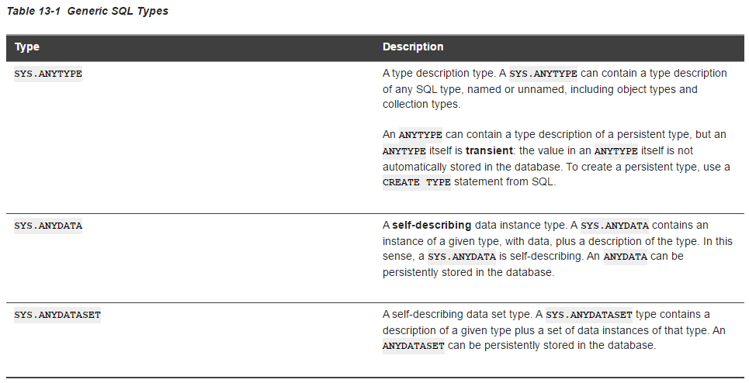

Slide 20
References:
document-1:
http://docs.oracle.com/cd/B19306_01/appdev.102/b14289/dcitblfns.htm
document-2: http://docs.oracle.com/cd/B19306_01/appdev.102/b14261/collection_definition.htm

Slide 21
Thank you All

